Slide 1
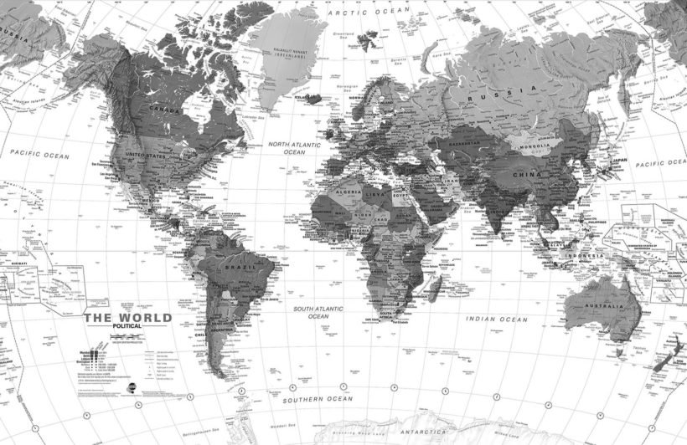

Survive In Bangalore
By: Aman Patel
Utkal University

Slide 2
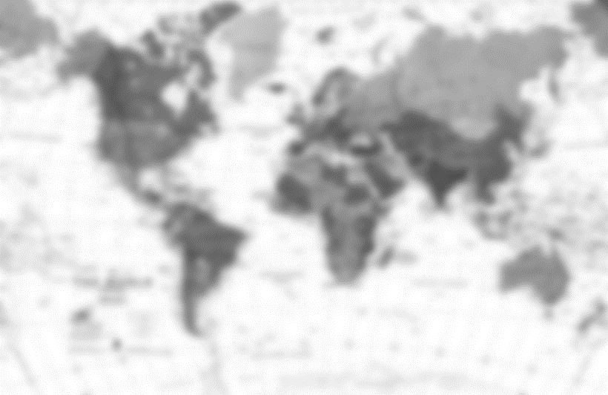
ABSTRACT:
This Project is based on Foursquare API, folium map and little bit data collection and analysis. For those who like to explore new places have a better opportunity to explore through python coding rather than exploring using the mobile to locate your desired places.

Slide 3
Introduction/Business Problem:
Suppose I have completed my Post Graduation in Statistics from Bhubaneswar, Odisha and moving to Bangalore for higher studies in Data science. Although you have much idea to survive in new places, asking to neighbour hood friends and your instructors also room-mate. But what if you have not been to Bangalore prior to this, also you dont have bike to explore the new place. So dont worry about it, we have our friendly app foursquare to help us in our journey.
Using the Developer option we can gather data from all over the BTM Layout Area of Bangaluru, and use the relevant data for our decision making purpose.
Right after Deciding Where to Study: . Search for Nearby ATM to Collect cash. . Search for Nearby PG. . Search for Hotels, Cafe near your location.

Slide 4
Data Collection:
First of all we need the latitude and longitude of the place “BTM LAYOUT”
Then Decide the range of 2 km, from the ExcelR Solutions
Place Name:
Place Category:
Place distance from BTM Layout center:
Place Longitude, Latitude:
Place Like:
Place Ratings:
Data can be collected using foursquare developer facilities

Slide 5
Data Collection Procedure:
Here we define our location Address as address and locate the longitude and latitude of the place where we are going to search for our P.G.
address = '1st Stage, BTM Layout'
geolocator = Nominatim(user_agent="foursquare_agent")
location = geolocator.geocode(address)
latitude = location.latitude
longitude = location.longitude
print(latitude, longitude)
Using my Client Id and Client Secret, I can Access the data from foursquareAPI
search_query = 'atm,pg'
radius = 2000
Radious is 2000 for 2 km of radious.
url = 'https://api.foursquare.com/v2/venues/search?client_id={}&client_secret={}&ll={},{}&v={}&query={}&radius={}&limit={}'.format(CLIENT_ID, CLIENT_SECRET, latitude, longitude, VERSION, search_query, radius, LIMIT)
Now we can get the result using
results = requests.get(url).json()
results

Slide 6
Data Cleaning:
venues = results['response']['venues’]
Here we normalize the json data to Data frame for exploration purpose.
dataframe = json_normalize(venues)
dataframe
Now keep only columns that include venue name, and anything that is associated with location
filtered_columns = ['name', 'categories'] + [col for col in dataframe.columns if col.startswith('location.')] + ['id']
dataframe_filtered = dataframe.loc[:, filtered_columns]
Filter the category column :
def get_category_type(row):
try:
categories_list = row['categories']
except:
categories_list = row['venue.categories']
if len(categories_list) == 0:
return None
else:
return categories_list[0]['name’]
dataframe_filtered['categories'] = dataframe_filtered.apply(get_category_type, axis=1)

Slide 7

 | name | categories | location.address | location.distance | location.lat | location.lng | location.postalCode | id
0 | Kotak Mahindra Bank - ATM | Bank | Shop No. 5 Ground Floor,Akshay Complex No. 1,PID No. 65-27-1 16th Main Road B.T.M. 2nd Stage 1st Phase Extension | 165 | 12.9161261 | 77.60987626 | 560076 | 4fb283a27bebc1fb6507015d
1 | Paying Guest Hostel(PG) | Residential Building (Apartment / Condo) | Maruthi Layout | 366 | 12.92038155 | 77.60798645 |  | 4fc377c4e4b06a3981d13063
2 | Axis Bank ATM | ATM | No 1214, Near Dominos Pizza Road | 281 | 12.91497993 | 77.61006165 | 560029 | 5c2b49aaacc5f5002c581306
3 | Mohan Reddy's Pg | Assisted Living | Sg Palya | 1857 | 12.93381327 | 77.6073801 |  | 50604726e4b0d9a2f221902c
4 | Life Style PG | Residential Building (Apartment / Condo) |  | 535 | 12.917783 | 77.6137 |  | 56d69117498e82920b369d03
5 | Allahabad Bank Atm | Bank |  | 409 | 12.91387089 | 77.61043017 |  | 518490e0498edeecfbbaadfc
6 | SSSB PG | Residential Building (Apartment / Condo) | 16, Venkateswara Layout | 1873 | 12.93396049 | 77.60740883 |  | 557412e2498e17b865efe712
7 | Delight Pg For ladies | Residential Building (Apartment / Condo) |  | 1005 | 12.923537 | 77.615398 |  | 574b231c498e18aea0804c05
8 | sln pg | Assisted Living |  | 749 | 12.92279053 | 77.61263275 |  | 5221dde4498e569a0b14fbd3
9 | Shri Sai Bhavani PG | Residential Building (Apartment / Condo) | 61/1 | 737 | 12.9185 | 77.615463 | 560068 | 5880f589084be55c00a77fdb
10 | SLV Gents PG | Assisted Living |  | 932 | 12.9230938 | 77.61490631 |  | 52d7da58498e9d11a54660c6
11 | Emirates pg | Assisted Living | Tavarekere | 759 | 12.923989 | 77.609385 | 560029 | 53a6d2d0498e56d9917a0d8b
12 | Sri lakshmi Venkateshwara Ladies Pg | Hostel | Plot No. 16 , 30th Main , | 743 | 12.91508943 | 77.61531449 | 560076 | 5625bf3a498e48241b098cbd
13 | Raja rajeshwari pg |  | btm,madiwala | 817 | 12.92004961 | 77.61574529 |  | 525acb41498e3976736b12f9
14 | HDFC Bank ATM | Bank | 1224, 17Th Main, 8Th Cross, Btm 1St Stage Maruthinagar Main Road Near Gangotri Bar & Restarunt | 396 | 12.91984 | 77.611248 |  | 5303a0d411d2eac30b632836
15 | Brundhavan PG | Assisted Living |  | 900 | 12.9110899 | 77.60335541 |  | 53889843498e264f18c0be2c
16 | Canara Bank ATM | Bank |  | 403 | 12.91412522 | 77.61078825 |  | 50cc7f6ce4b0881a7314b7a5
17 | Sbi Atm | Bank |  | 376 | 12.91383925 | 77.60832966 |  | 4e7586c27d8b9176031d6de9
18 | HDFC Bank ATM | Bank | No, 397, 7Th Cross, 9Th Main, Mico Layout, Btm 2Nd Stage. Behind Shopers Stop | 427 | 12.913606 | 77.607388 |  | 5303a0df11d2eac30b648457
19 | Citibank ATM | Bank | BTM Layout | 433 | 12.91509555 | 77.6121702 | 560029 | 4c28ecb4ed0ac9b654fe60aa
20 | Chennakeshava PG | Housing Development |  | 974 | 12.92008305 | 77.61727905 |  | 4fc58935e4b0035511cfad38
21 | Anjaneya pg,madivala | Residential Building (Apartment / Condo) |  | 1257 | 12.92221752 | 77.619186 |  | 53909437498e57a5dc08d085
22 | ICICI ATM | Bank | 100 Feet Outer Ring Road | 547 | 12.91663691 | 77.60379431 |  | 50f40a58e4b06080d312dbf3
23 | HDFC Bank ATM | Bank | 70, Shop No 2, Adarsha, 100Ft Road Btm Layout 2Nd Stage Near Jaydeva Flyover Next To Icici Bank | 526 | 12.91314846 | 77.6062842 |  | 5303a0d411d2eac30b632628
24 | HSBC ATM | Bank | BTM Layout | 469 | 12.913409 | 77.606892 | 560029 | 4c1fa330eac020a1ee644bc2
25 | Svs pg |  |  | 1039 | 12.92422439 | 77.61510582 |  | 52f7b43d11d28d688c3ab23f
26 | new paradise Mens pg | Residential Building (Apartment / Condo) |  | 1013 | 12.92530622 | 77.61303181 |  | 530c14ad498e6f99f1a0ed8a
27 | Susheela PG | Assisted Living |  | 1028 | 12.909909 | 77.602962 |  | 536ee5dc498e6848bddec519
28 | maharashtra bank atm | Bank |  | 499 | 12.9133 | 77.6065 |  | 4f2fe0d9e4b0b0d0865e516b
29 | Rajarajashwari PG 4 Men | Residential Building (Apartment / Condo) | Madiwala | 1017 | 12.9197044 | 77.61781592 |  | 4e3ed22d52b1a04aff2a3788

Slide 8
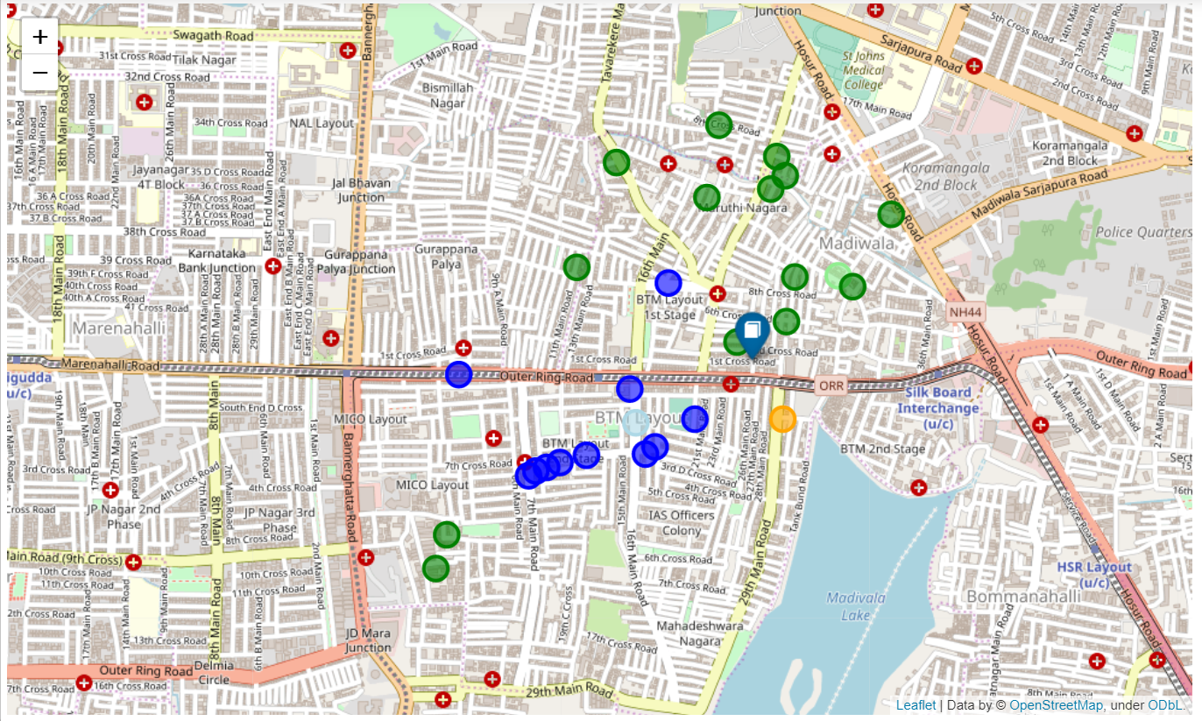
The Location With Book Mark in blue color is representing the ExcelR Solution, Place Where We are Doing our higher Studies.
Blue Marks are Bank and ATM
Green are PG, Hostels, Rooms, Hotels.

Slide 9
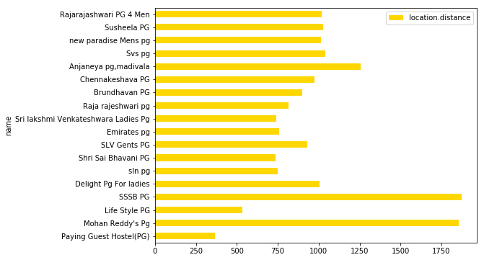
Data Exploration:

Slide 10
Conclusion:
Finally due to inadequate data, so we have concluded that
The place Shri Sai Bhabani P.G. will be best place to live.

